Slide 1
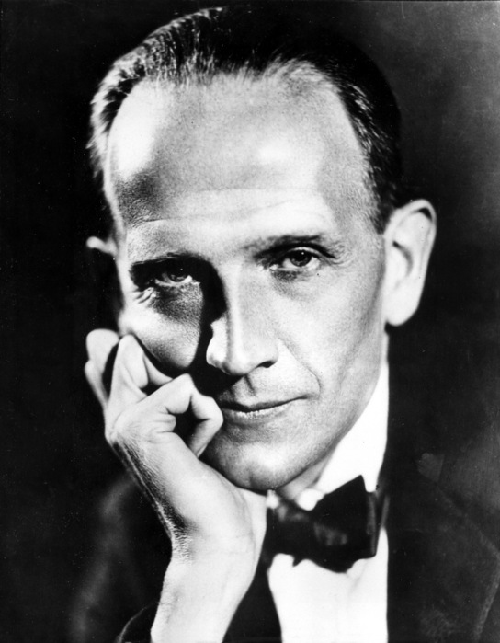
Alan A. Milne

Slide 2
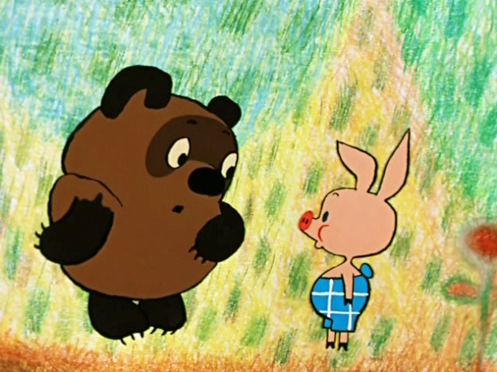
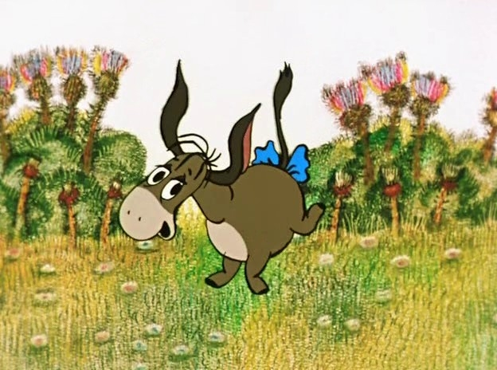
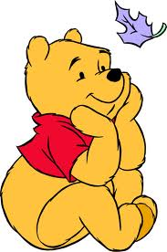
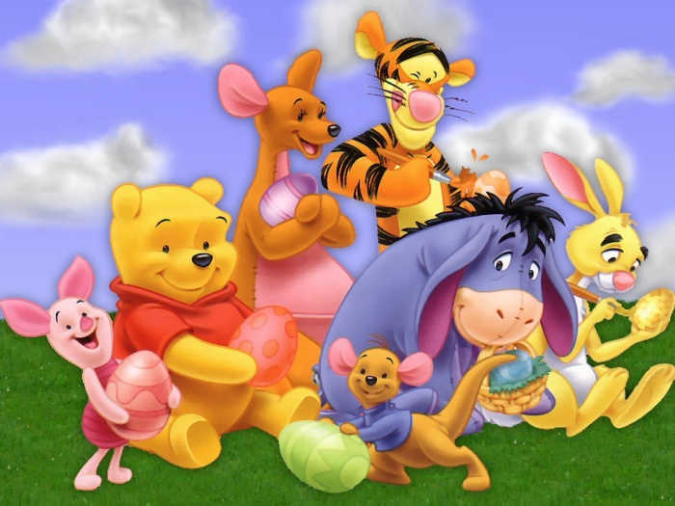
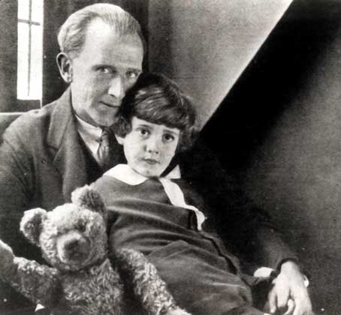
Alan Alexander Milne
Dorothy De Selincourt
Daphne
Ashdown Forest
Winnie-the-Pooh
Dartmouth
Eeyore
Piglet

Slide 3
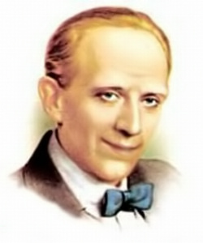
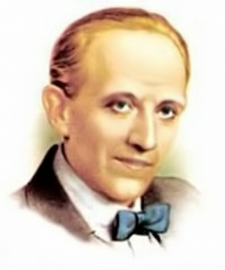
Alan Alexander Milne’s father was a doctor.

Slide 4
Milne became a mathematician.

Slide 5
In London Milne worked for a famous magazine.

Slide 6
Christopher Robin is the name of a bear.

Slide 7
Milne wrote a lot of poems for Christopher Robin.

Slide 8
Milne wrote a book about Winnie-the-Pooh.

Slide 9
Milne drew illustrations for his book himself.

Slide 10
Now Christopher Robin’s old toys are in Australia.

Slide 11
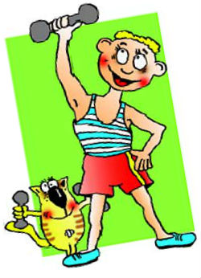
Let’s warm up!

Slide 12
Answer key
1. a
Mark:
2. Alan Milne joined the army in 1914.
3. The name of his son is Christopher Robin
4. the headmaster of a small preparatory school
5. salary
6. adorable son
7. Teddy bear
Very good – 7 correct answers;
Good – 5-7 correct answers;
Sat – 4 correct answers;
Poor – less than 4 correct answers.

Slide 13
1)Was it interesting for you to know about Alan Milne? 2)Can you speak about his life now? 3)And about Winnie-the-Pooh?

Slide 14
H/w: continue the story of Winnie-the-Pooh, write what happened to his life in the museum

