Slide 1
A big black bug bit the big black bear, but the big black bear bit the big black bug back.

Slide 2
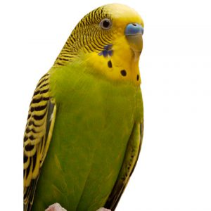
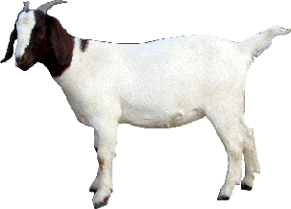
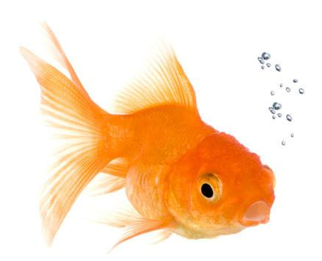
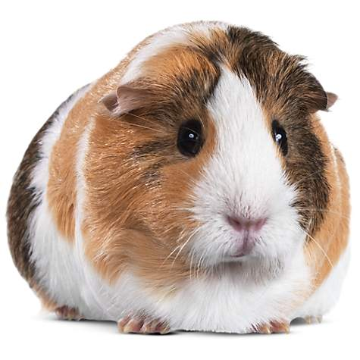
budgie ['bedʒɪ] goat [gəut] goldfish ['gəuldfɪʃ] guinea pig ['gɪnɪpɪg]

Slide 3
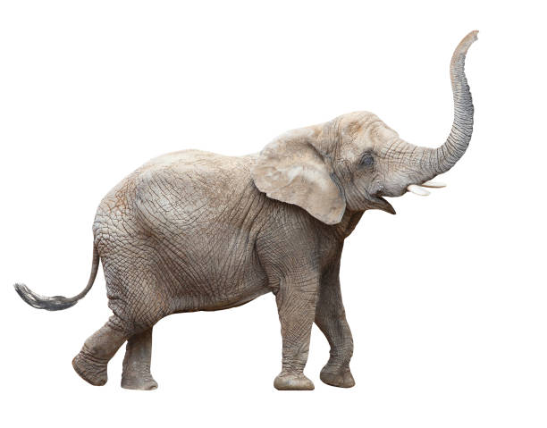
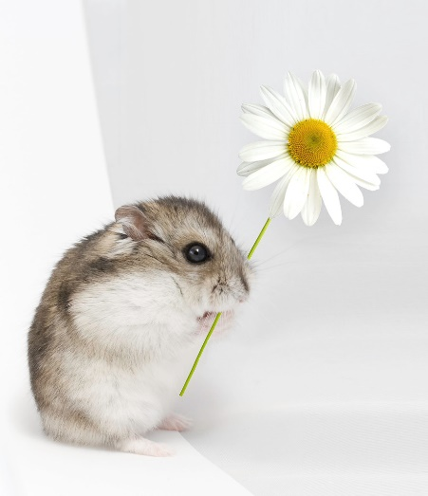
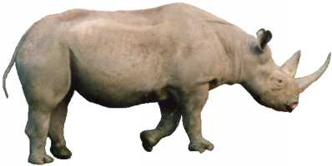
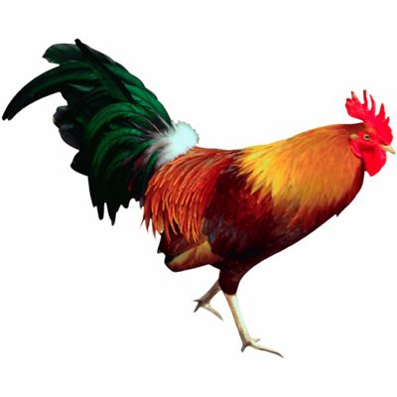
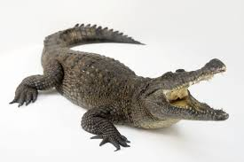
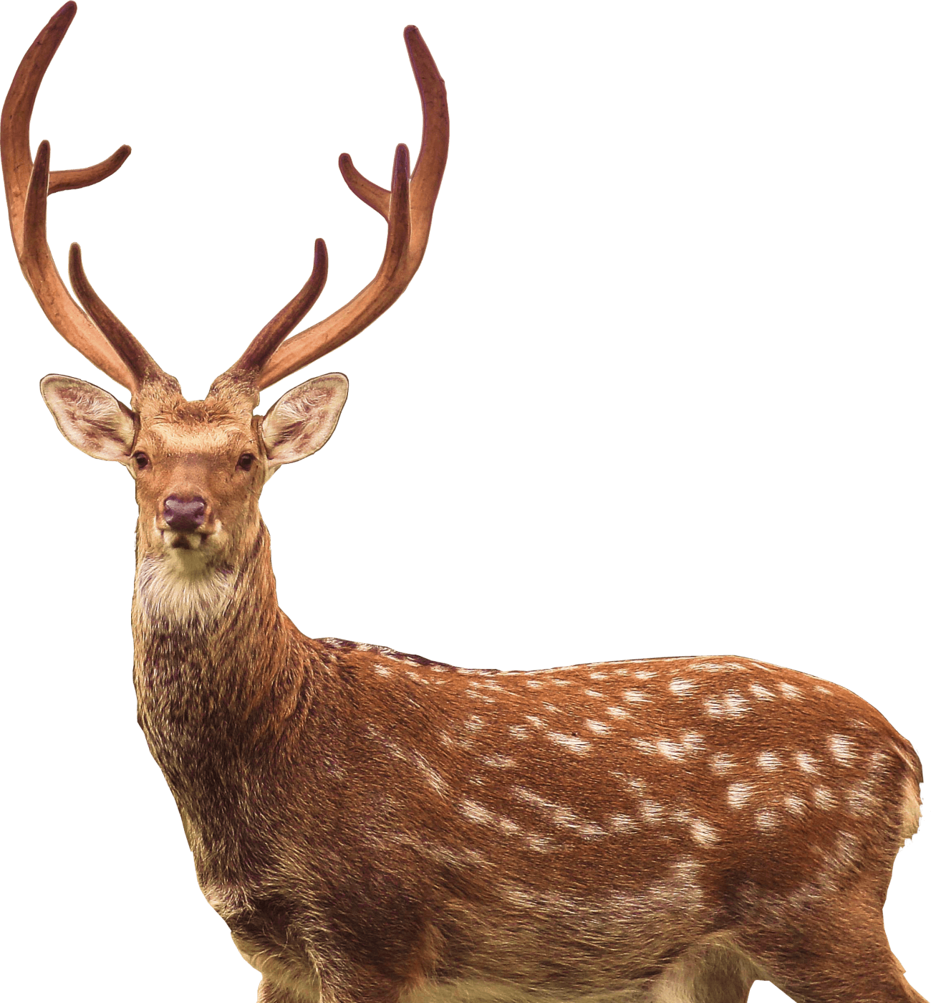
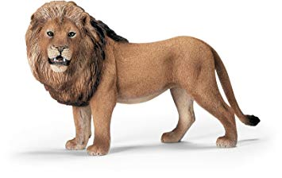
14 elephant
15 rhino
17 humster
16 chicken
20 crocodile
19 deer
18 lion

Slide 4
pets | farm animals | wild animals
dog goldfish tortoise rabbit cat budgie guinea pig humster | rabbit sheep goat cow duck goose hen chicken | elephant rhino lion deer crocodile

Slide 5
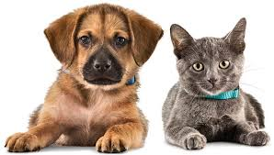
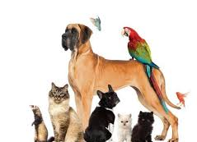
1. What pet has each person got? 2. What are their pets’ names? 3. How old are they? 4. What do they usually do?

Slide 6
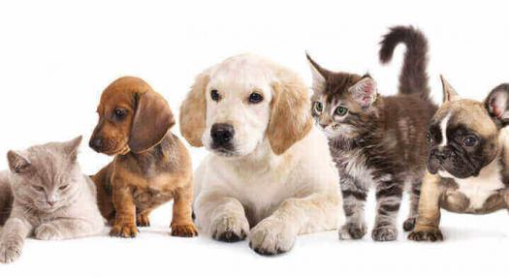
Homework Post your message to the forum. Write about: 1) type of pet 2) name 3) age 4) description 5) activities

